Slide 1
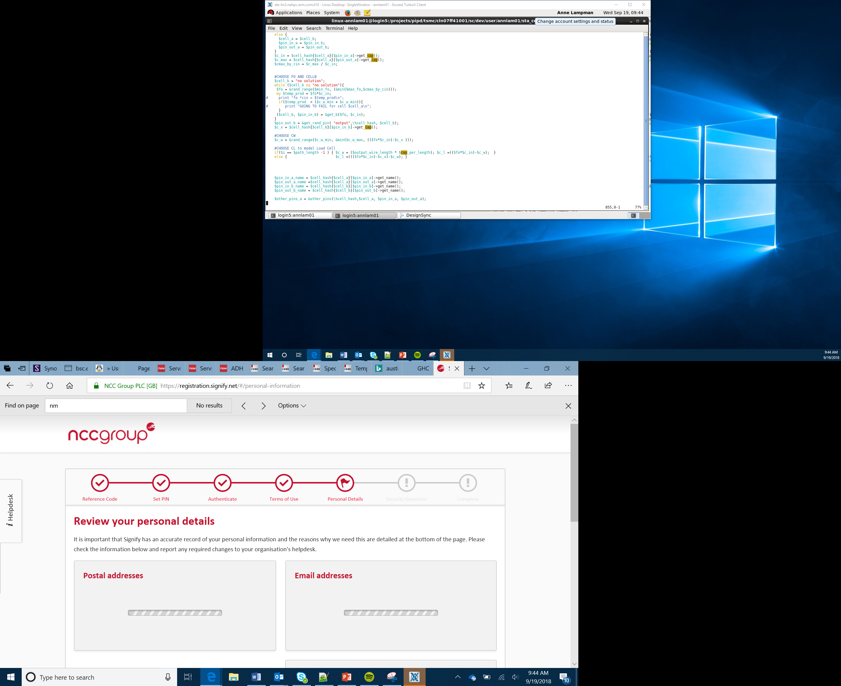

Smart Robotics Project
The Brain
Lesson 16

Slide 2
Objectives
To identify some examples of embedded systems
To have created examples of code in both text and block-based languages
To produce functional algorithms using block code
To identify the benefits and disadvantages of both block and text-based coding

Slide 3
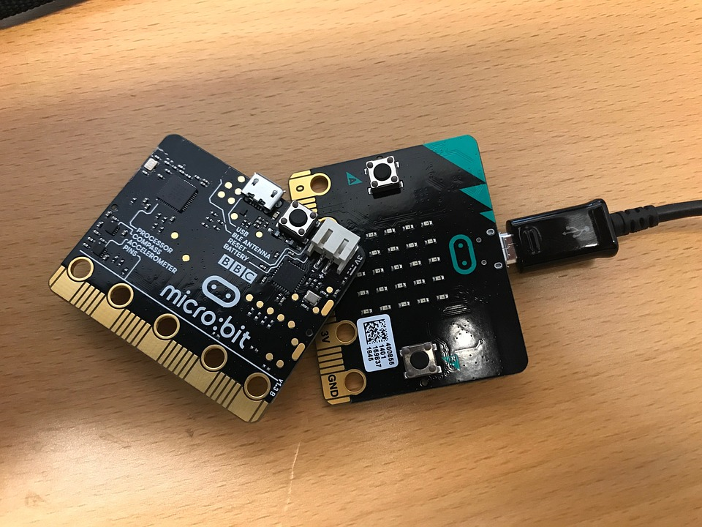
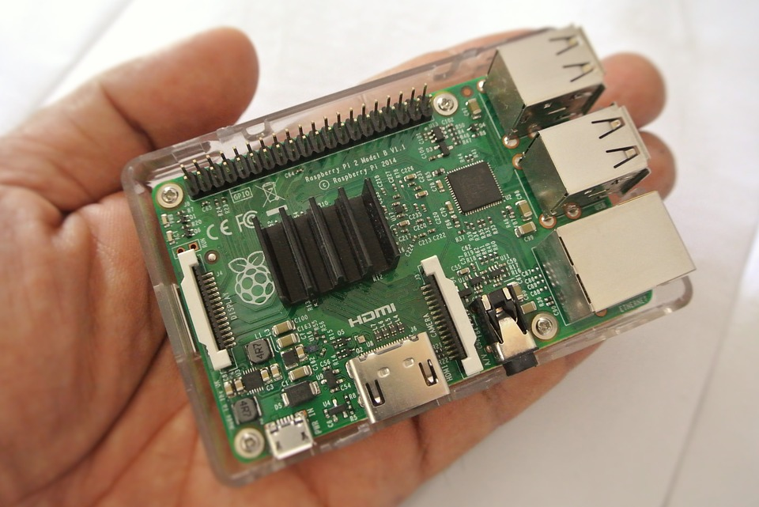
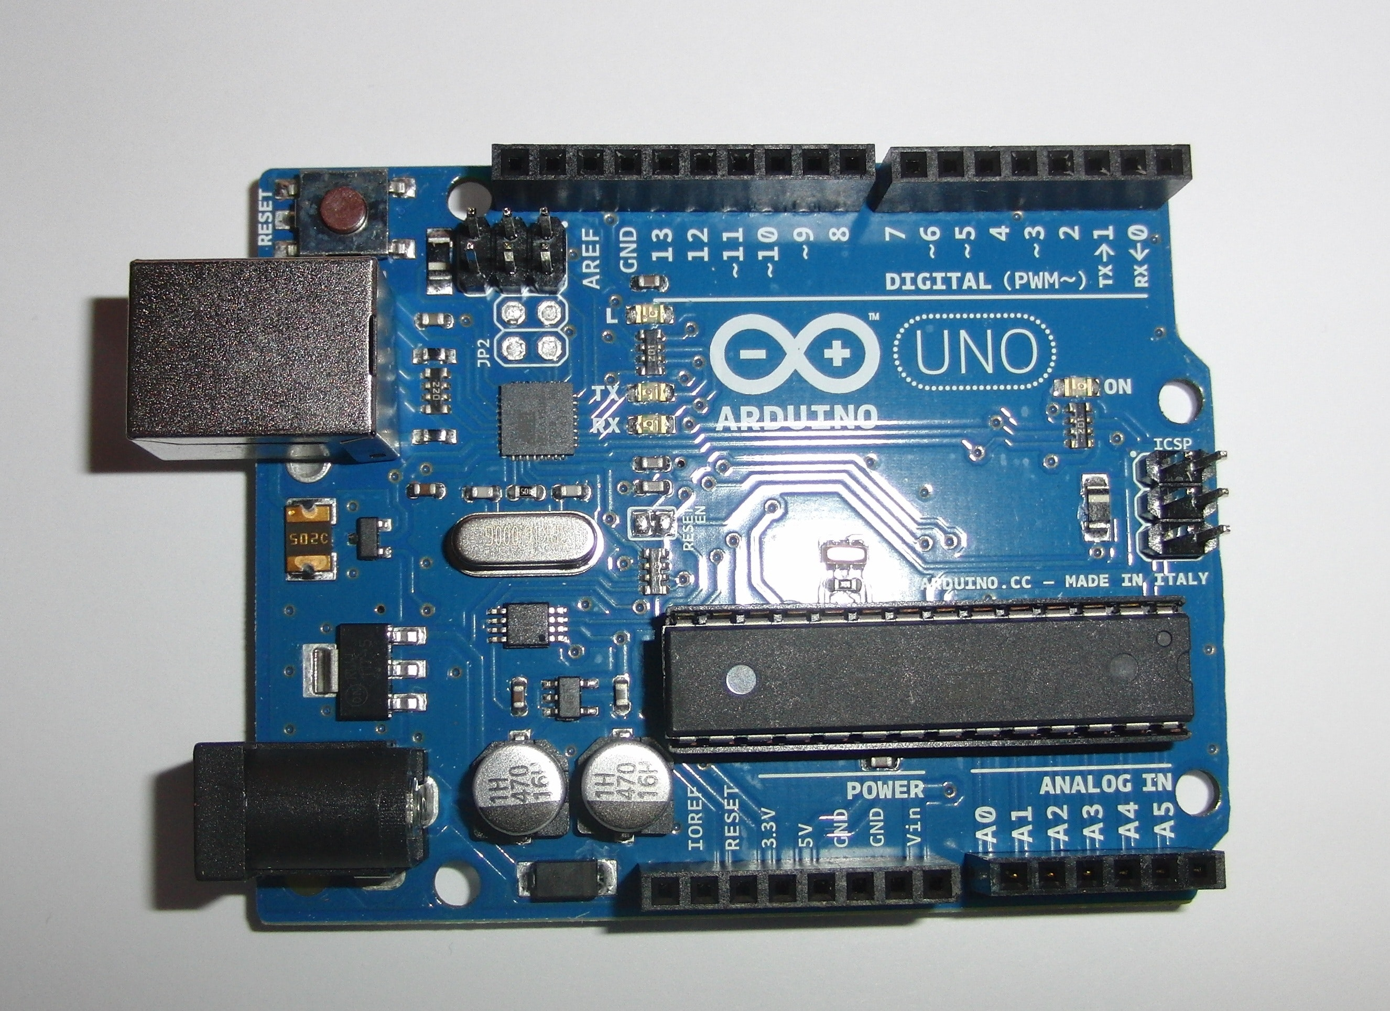
Embedded Systems
An embedded system is a computer system built in to a larger system that is programmed to do a specific single task or a range of tasks for a single purpose
The onboard computer (The micro:bit in our case) controls the entire system
The CPU (Central Processing Unit):
Acts like the brain of the system
Interact and communicate with the hardware
Follows the instructions that you have programmed it to do
This is called the CPUs fetch, decode, execute cycle
Notes:
All pictures listed on google as being tagged for re-use even commercial
Describe embedded systems, give some examples eg PVRs, Washing Machines etc – look at a range of development systems similar to the micro:bit that are used to create embedded systems eg Banana Pi, Arduino and Raspberry Pi
Explain how these can be used as the computer within an embedded system. Again refer to the micro:bit as being the main processor for our Bit:Bot and how this is an embedded system within our self-drive car

Slide 4
Embedded Systems
The CPU has a fixed set of instructions
The programming development environment (IDE) compiles your program into instructions the CPU can understand
It doesn’t matter what we program in (Blocks or Text based code) as it all gets compiled into the CPU’s instruction set
The CPU can then
Fetch these instructions from memory (RAM)
Decode these instructions (look them up in its instruction set)
Execute these instructions (run the command)
The interface or program (IDE) lets you
Take inputs from the hardware (CPU, Sensors, LEDs, etc), the environment or human user
Process these
Create appropriate outputs
Notes:
Describe embedded systems, give some examples eg PVRs, Washing Machines etc – look at a range of development systems similar to the micro:bit that are used to create embedded systems eg Banana Pi, Arduino and Raspberry Pi
Explain how these can be used as the computer within an embedded system. Again refer to the micro:bit as being the main processor for our Bit:Bot and how this is an embedded system within our self-drive car

Slide 5
Block or Text
This is a very hot topic and often up for debate!
Block Programming
Text Based Programming
Gives you a good introduction to the logic of coding and the techniques needed to take and idea, decompose the problem and develop a solution
It does sometimes hold your hand
Focussed on the solution not the code you are less likely to make mistakes but are restricted by the blocks available
Coding in a text based language like Python, is the way you will write code as a computer programmer
Harder to learn, but a greater sense of achievement when it works
Allows more control over the device you are programming
Notes:
Discuss the relevant merits of Block programming and Text-based coding
Explain how block coding allows you to learn the key programming constructions and how to apply them without having the worry about the language specific syntax at this stage
Ensure Learners realise that block programming is not much used outside education and text based programming allows a much greater level of control over the device you are programming

Slide 6
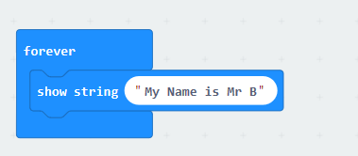
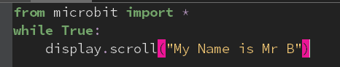
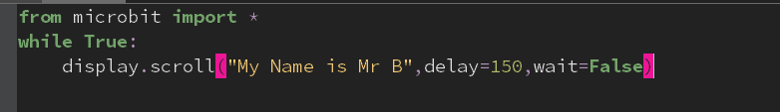
Block or Text
The block code right and Python below do exactly the same thing
With the blocks you are less likely to get it wrong – the block won’t click together if there is a problem
The code in Python won’t work if you mistype or miss a speech mark out – you can flash the micro:bit but just get an error
Using the code in Python we can give much more precise commands, e.g. I can:
Tell it to delay before it starts scrolling
Tell it not to wait for the scroll to finish before running the next line
This gives me much greater control over what is happening
Notes:
Demonstrate how block and text can be used to do the same things, how easy it is to make mistakes but the greater level of control you have with text.

Slide 7
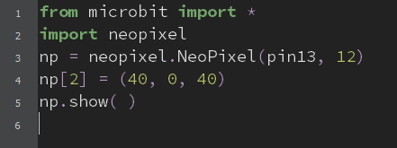
Python Examples
Use https://python.microbit.org/v/1.1
Start by trying the example below with your micro:bit plugged into your Bit:Bot
All it does is change an LED to purple – experiment see how you would change different LEDs or to different colours
Take a look at the example code to see how the Bit:Bot can be controlled using MicroPython
Notes:
Mu is a free offline Python for Micro:bit and can be downloaded from https://codewith.mu/en/download
Demonstrate how Python can be used to control the Neopixel strip on your Bit:Bot
There is some demo code to look at other functionality in Python

Slide 8
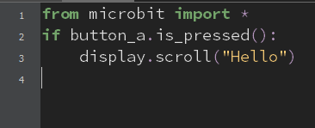
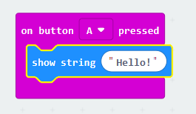
Event Driven Programming
Event driven programming is where events control the flow of the program
Events can be:
User actions (button presses)
Sensor outputs
Messages from other program
Event-driven programming is the dominant method in graphical user interfaces and other applications that need to respond to inputs
Notes:
Explain the paradigm of event driven programming. Refer to real world examples eg Windows
Use Mu or MicroPython from the micro:bit.org website to demonstrate the two pieces of code above.
Let Learners experiment

Slide 9
Functional Programming
Functional programming treats computation as the evaluation of mathematical functions
In functional code, the output value of a function depends only on the arguments that are passed to it
Calling a function twice with the same value produces the same result each time
Functions are a method of creating reusable code blocks that stop you unnecessarily repeating lines of code and wasting memory
Notes:
Discuss the paradigm or functional programming and how functions can be re-used in different programs and how this re-usability makes this form of development more efficient

Slide 10
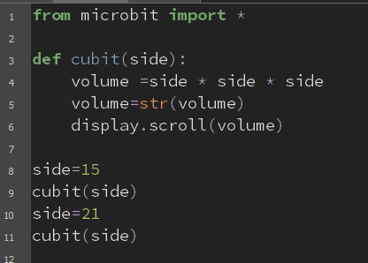
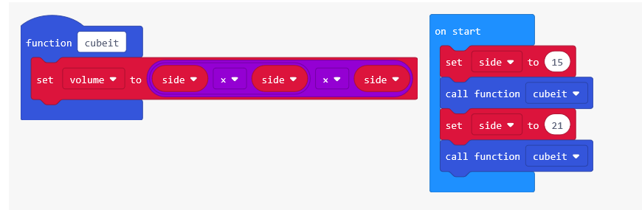
Functional Programming
The example uses a function in MakeCode or MicroPython to cube a value:
The first time the function is called it cubes 15
The second time it cubes 21
Look at how the function is defined in both versions
Modify the MakeCode code to display the result of the function call
Notes:
Demonstrate how simple functions can be created using blocky and Python (see example above)
Get Learners to try this
Ask them to look at the two code examples and modify the cubit function to display the result of the function

Slide 11
Success Criteria
Identify some examples of embedded systems
Create examples of code in both block and text-based languages
Produce functional algorithms using block code
Identify the benefits and disadvantages of both block and text-based coding
Notes:
Introduce the Task and Activity Sheet
Support an encourage Learners to attempt the Stretch Tasks

